Slide 1
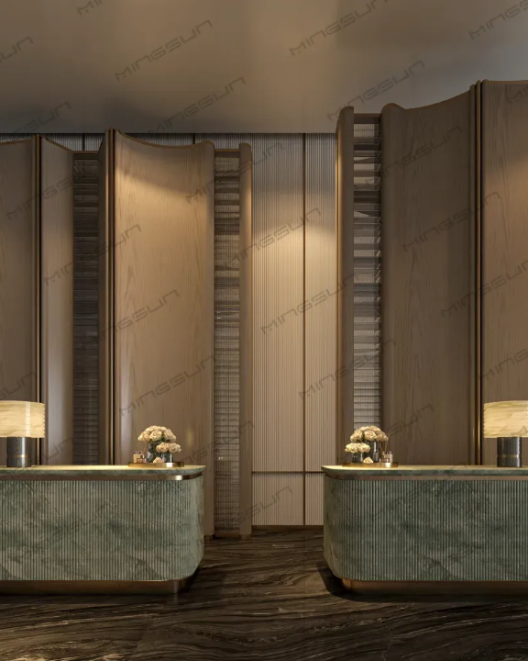
INTRODUCTION & CONTEXT
Luxury at Scale Requires Flawless Data
Shangri-La Colombo operates at the pinnacle of hospitality. Managing premium guest experiences, dynamic room inventory, and secure financial transactions demands a robust backend architecture.
500+
24/7
Zero
Rooms & Suites
Operation Demand
Margin for Error
Our Mandate: Engineer a centralized, normalized relational database to unify these core operations.

